Slide 1

Identifying Misrepresentations of Weight Loss Supplements
Liam Horton
Jeanette Harris
Jason Moore
Jason Van Wyck
Notes:
Jeanette

Slide 2
Business Case
The U.S. vitamin & supplement manufacturing industry
Worth $35.6 billion annually
Expected to grow 6.9% annually between 2021 and 2026.
Vitamins and supplements classified as food products not medicine,
Not regulated via the strict standards governing the sale of prescription and over-the-counter drugs
FDA is limited to post market enforcement
There are no provisions in the law for FDA to approve dietary supplements for safety before they reach the consumer.
This lack of regulatory oversight lends itself to an array of false promises. making it a potentially strong avenue to identify ineffective, falsely advertised, and misrepresented products.
Lack of regulatory oversight makes it necessary for firms like Amazon to identify and remove falsely advertised products due to the potential heath risks they expose customers to.
Selling falsely advertised, non-regulated products could draw claims of negligence in both the public/legal spheres
Regulatory bodies (i.e., FDA) will also have interest in identifying and removing falsely advertised products once they reach market, imposing penalties on producers
Notes:
Jeanette

Slide 3
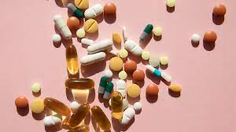
Business Case
Through a detailed analysis Amazon’s supplement reviews, we believe that we will be able to:
Determine what types of words/phrases generally correspond to misrepresentation of the products.
Enhance consumer knowledge, lead them to more informed purchasing decisions
Impact bottom line of bad actors by removing medium through which they sell their product
Steer consumers away from supplements that may have a negative effect on their short/long term health.

Slide 4
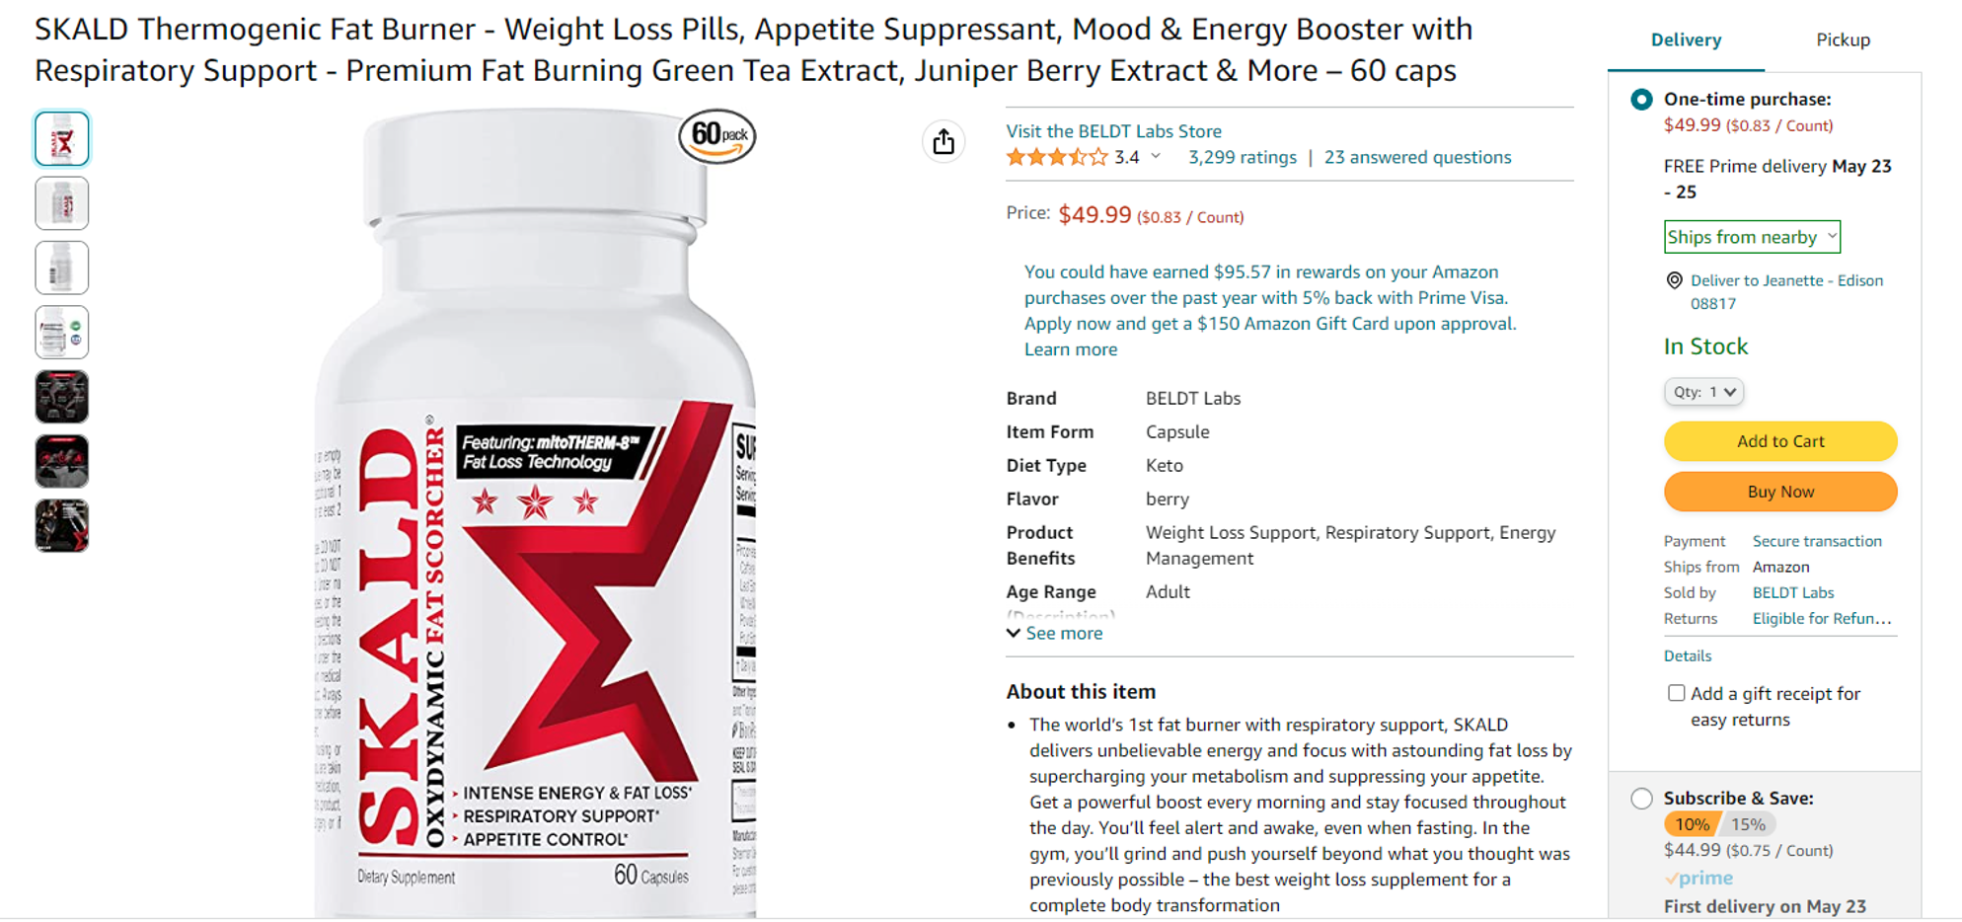
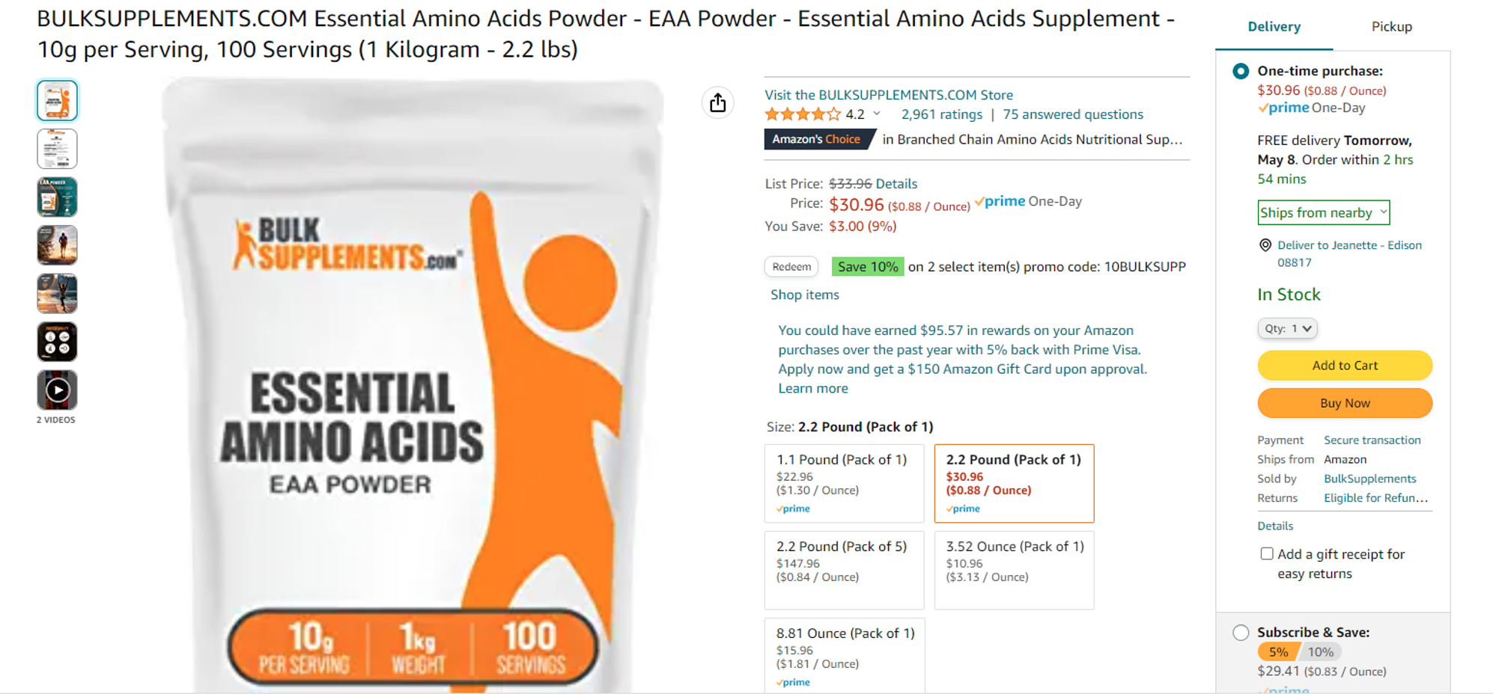
Product Selection
Skald Fat Burner
Used for primary model building
492 usable reviews
251 Misrepresentations
241 Confirm product claims
Cohen’s Kappa of 0.88 amongst labelers
Amino Acid Powder
Used for transfer learning
511 usable reviews
176 Misrepresentations
335 Confirm product claims
Cohen’s Kappa of 0.70 amongst labelers
Notes:
Jason V.
Cohen’s Kappa – statistic used to measure the inter-rater reliability which is the degree of agreement between independent observers.
Inter rater reliability of .70 – Amino Acid
.88 – Fat Burner

Slide 5
Skald Fat Burner Model Selection
Model | Precision | Recall | F-1 | ROC AUC
Logistic Regression | 0.93 | 0.81 | 0.87 | 0.93
SVM | 0.93 | 0.80 | 0.86 | 0.93
Decision Tree | 0.97 | 0.48 | 0.64 | 0.77
Ada Boost | 0.84 | 0.62 | 0.72 | 0.80
ANN | 0.95 | 0.80 | 0.87 | 0.93
Naive Bayes | 0.97 | 0.81 | 0.88 | 0.94
Keras Deep Learning | 0.76 | 0.90 | 0.82 | 0.90
Random Forrest | 0.66 | 0.83 | 0.73 | 0.79
Notes:
Liam

Slide 6
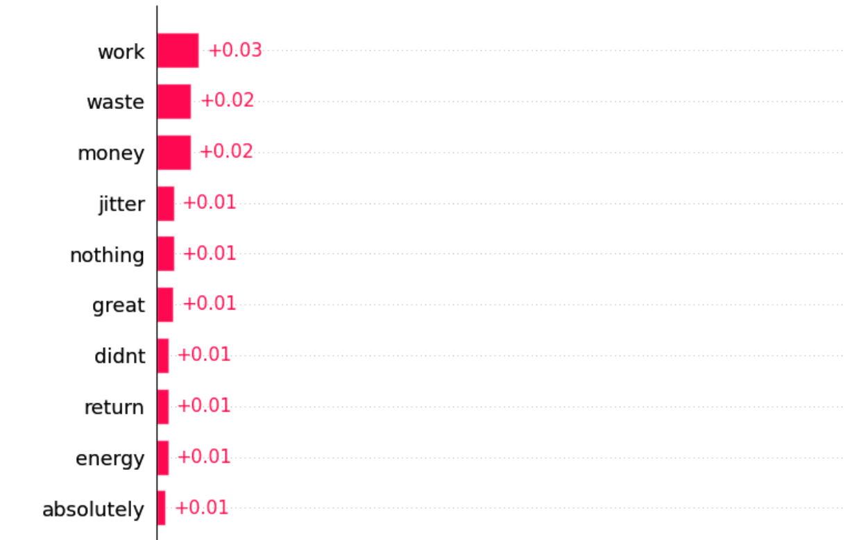

Skald Fat Burner Most Informative Words
Notes:
Jeanette

Slide 7
Skald Fat Burner Most Informative Words (In Context)
Date | Rating | Review
1-May-22 | 1 | This doesn't work. A waste of money. Doesn't work
25-Jul-21 | 1 | It didn't work, I was always hungry, always eating snacks...I don't recommend this to anyone.. my point of view....
20-Mar-23 | 1 | I was hopeful this would give me a little jump start on my weight loss journey. First day I felt they worked well. Next day felt sick. I only took one pill the day before a pill the next morning, Within an hour I felt so sick to my stomach. Felt sick most of the day. Please don't buy them awful pills and you will waste your money.
Notes:
Jeanette

Slide 8
Amino Acids Powder Model Selection
Model | Precision | Recall | F-1 | ROC AUC
Logistic Regression | 0 | 0 | 0 | 0.82
SVM | 0.68 | 0.77 | 0.72 | 0.83
Decision Tree | 0.49 | 0.62 | 0.55 | 0.67
Ada Boost | 0.54 | 0.79 | 0.64 | 0.77
ANN | 0 | 0 | 0 | 0.82
Naive Bayes | 0.71 | 0.79 | 0.75 | 0.87
Keras Deep Learning | 0.53 | 0.86 | 0.66 | 0.74
Random Forrest | 0.60 | 0.62 | 0.61 | 0.70
Notes:
Liam

Slide 9
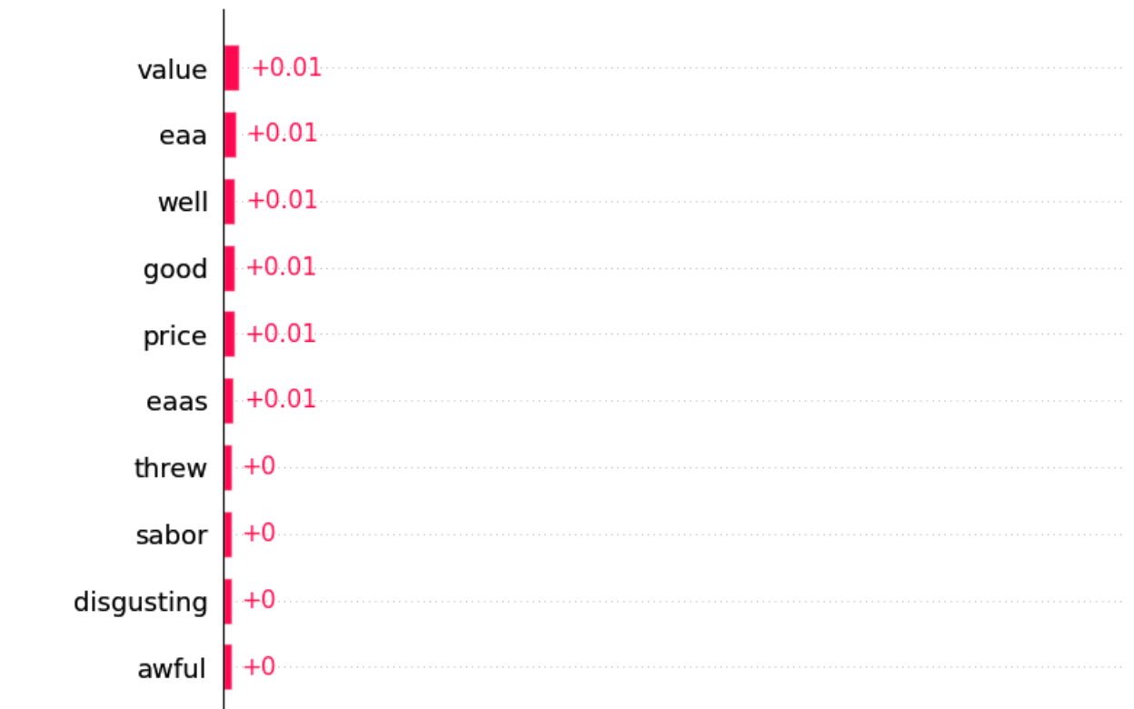
Amino Acids Powder Most Informative Words
Notes:
Jason M

Slide 10
Amino Acids Powder Most Informative Words (In Context)
Date | Rating | Review
29-Jul-21 | 1 | “The taste is disgusting. Threw the full bag in the trash.”
9-Jun-22 | 1 | “I didn’t see any results after a month of use, and it made my usual protein shake taste disgustingly bitter. I question the legitimacy of the product I received.”
28-Mar-23 | 3 | “I've taken this for 2 days now while maintaining my normal workout routine. I don't know if I feel any physical differences yet but I will say that it smells like bonemeal or beef broth and it tastes god awful, very bitter. I've tried adding it to cranberry juice and I've added it to my protein shake. It's been extremely hard for me to drink it...”
Notes:
Jason M

Slide 11
Assessment of Transfer Learning
Skald Fat Burner
Amino Acids
Model | Precision | Recall | F-1 | ROC AUC
Naïve Bayes | 0.51 | 0.74 | 0.60 | 0.73
SVM | 0.45 | 0.85 | 0.59 | 0.72
Model | Precision | Recall | F-1 | ROC AUC
Naïve Bayes | 0.57 | 0.93 | 0.71 | 0.71
Logistic Regression | 0.53 | 0.98 | 0.68 | 0.68
Notes:
Liam

Slide 12

Summary
Model performance demonstrates ability to build competent classifiers across 2 supplement types
Keywords analysis uncovered terms contributing to misrepresentation that appear within context of various reviews across product categories
As expected, given the claims associated with each product, the terms/phrases contributing to misrepresentation were quite different
Model performance also indicates a potential for transfer learning across supplement types
Notes:
Everyone

